Slide 1
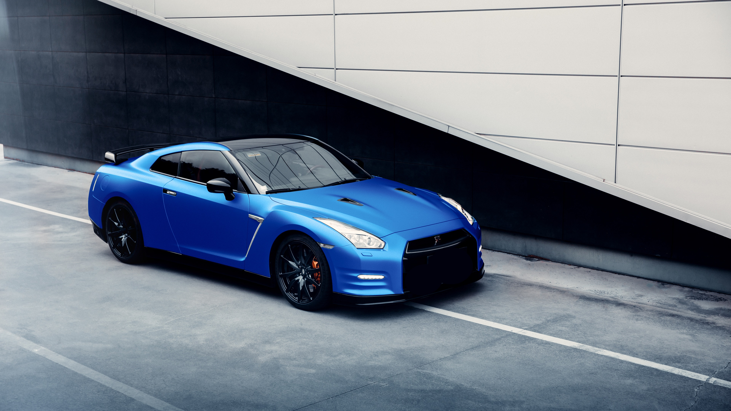
Drive Ease
Best Rental Cars in Lahore
Prepared by:
M . Samil 2025-GA-01
Faran Ahmed 2025-GA-15
Ahmed Mustafa 2025-GA-39
Adina Tanvir 2025-GA-47
Maham Javed 2025-GA-49

Slide 2

PROJECT OBJECTIVES
• Develop a responsive and user-friendly car rental website.
• Enable customers to view available cars and rental details.
• Integrate website data with Excel for business analysis.
• Demonstrate proficiency in HTML, CSS, and GitHub Pages.
• Provide a comprehensive project presentation.

Slide 3
Website Overview
• Home Page: Overview of services and highlights.
• Products Page: Catalog of cars, rental prices, and categories.
• Contact Page: Customer inquiries and booking information.
• Hosting: Live on GitHub Pages.

Slide 4
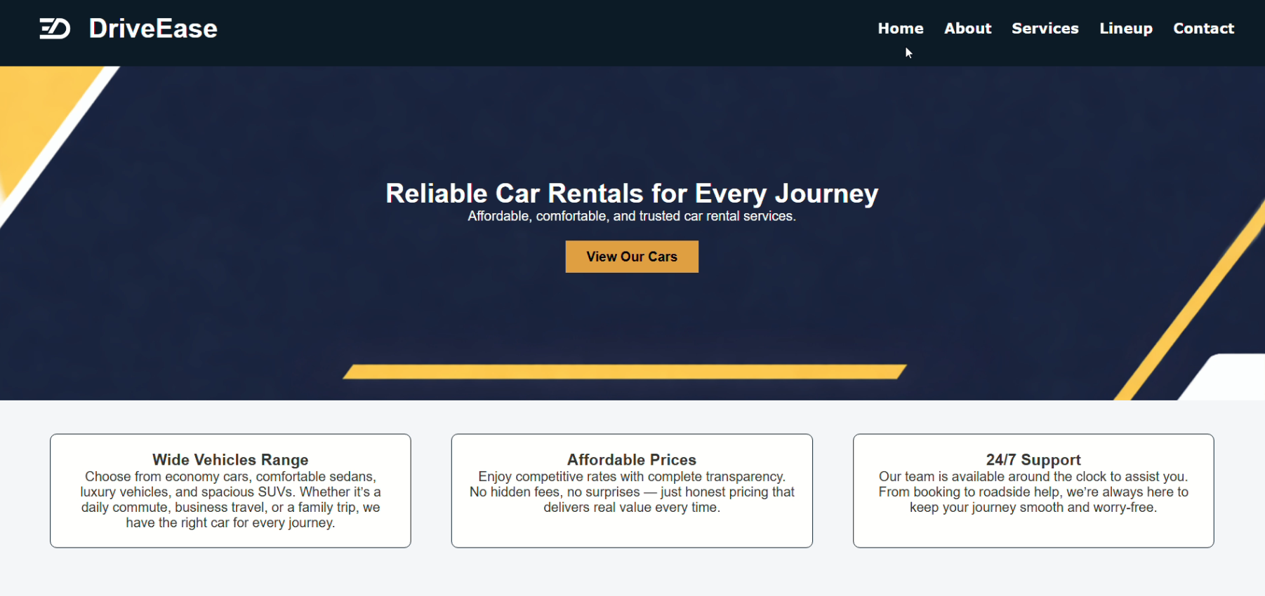
HOME PAGE
• Introductory banner with service highlights.
• Clean navigation bar for easy access.
• User-friendly layout.

Slide 5
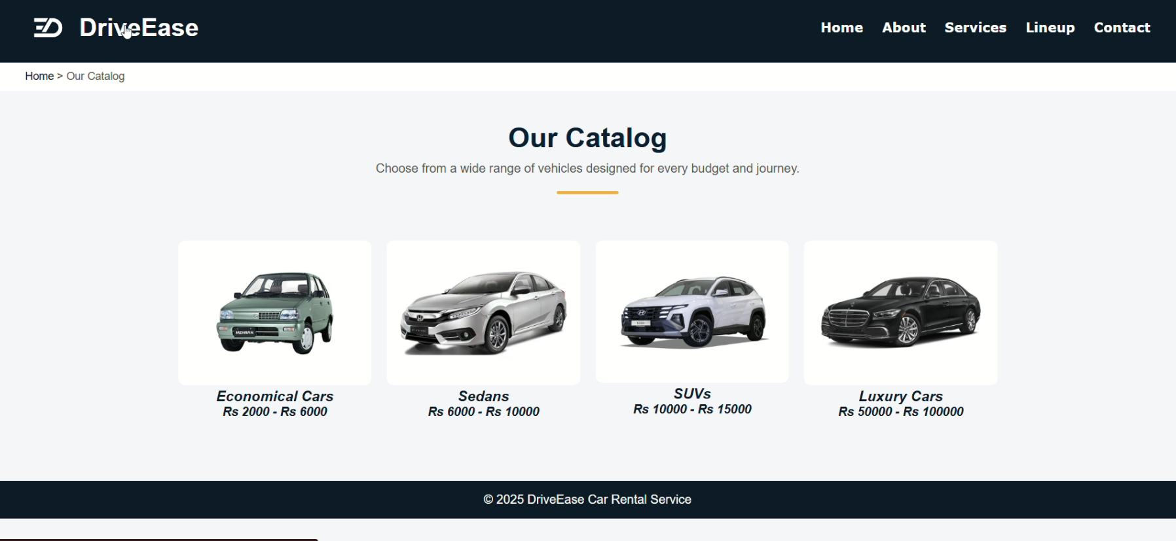
PRODUCTS PAGE:
• Car models, daily rental rates, and categories.
• Filterable or sorted list for easy selection.
• Clear, consistent formatting.

Slide 6
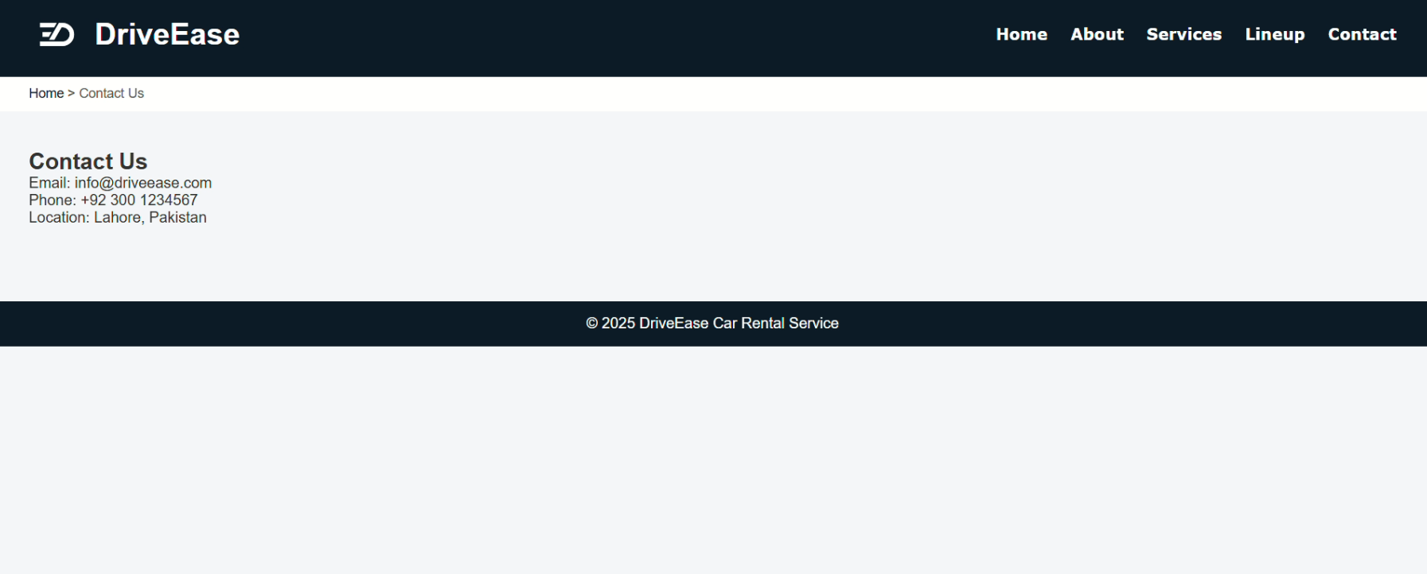
CONTACT PAGE:
• Contact form with fields for inquiries.
• Essential contact details (email, phone, address).
• Professional, uncluttered design.

Slide 7
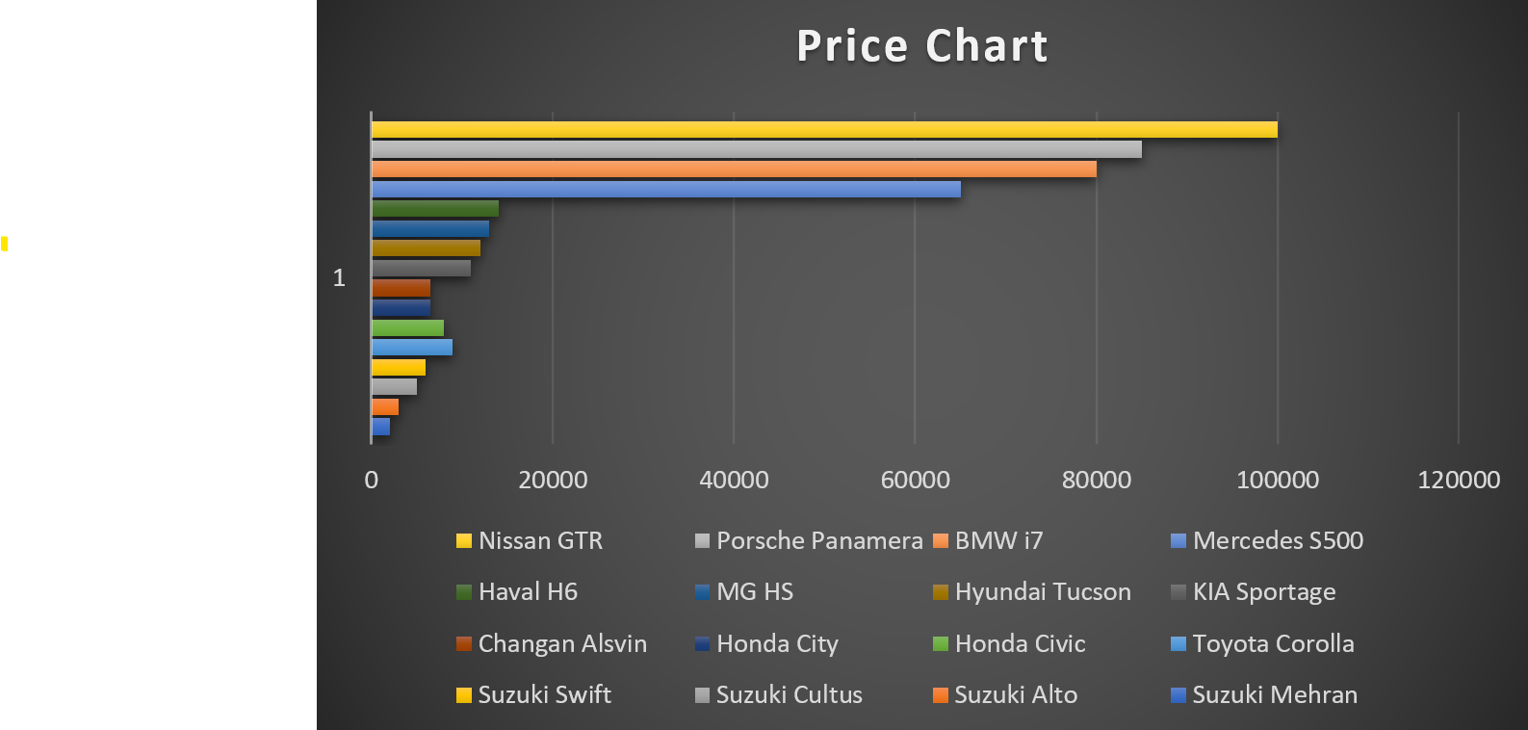
EXCEL DATA &ANALYSIS
Price comparison across 16 car models from economy to luxury segment.
Highlights affordability gaps, from Suzuki Mehran to Nissan GTR.
Useful for pricing strategy, market segmentation, and consumer targeting.
Supports decisions on fleet composition and premium offering.

Slide 8
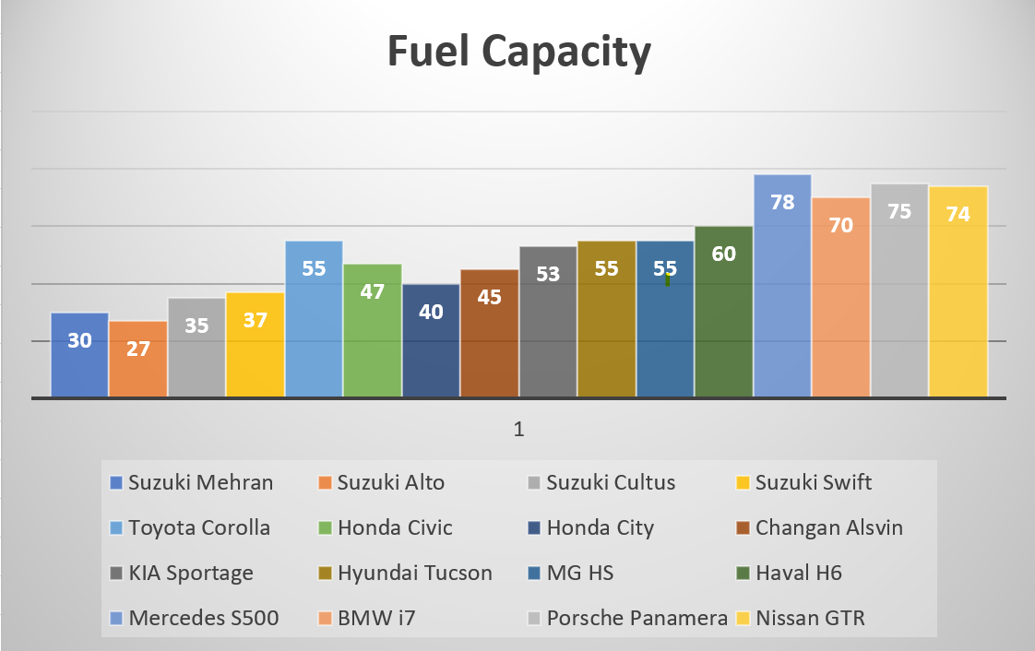
EXCEL DATA &ANALYSIS
Fuel capacity comparison across 16 car models from compact to luxury class.
Highlights range potential, from Suzuki Alto (27L) to Mercedes S500 (78L).
Useful for evaluating long-distance suitability and refueling frequency.
Supports decisions on fleet planning and fuel efficiency strategies.

Slide 9
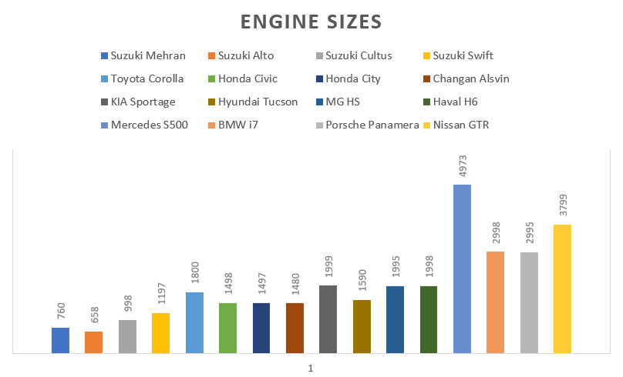
EXCEL DATA & ANALYSIS
Engine size comparison across 16 car models from compact to high-performance vehicles.
Ranges from Suzuki Alto (658 cc) to Mercedes S500 (4973 cc).
Useful for assessing power output, performance tiers, and fuel consumption expectations.
Supports decisions on vehicle classification and customer preference mapping.

Slide 10
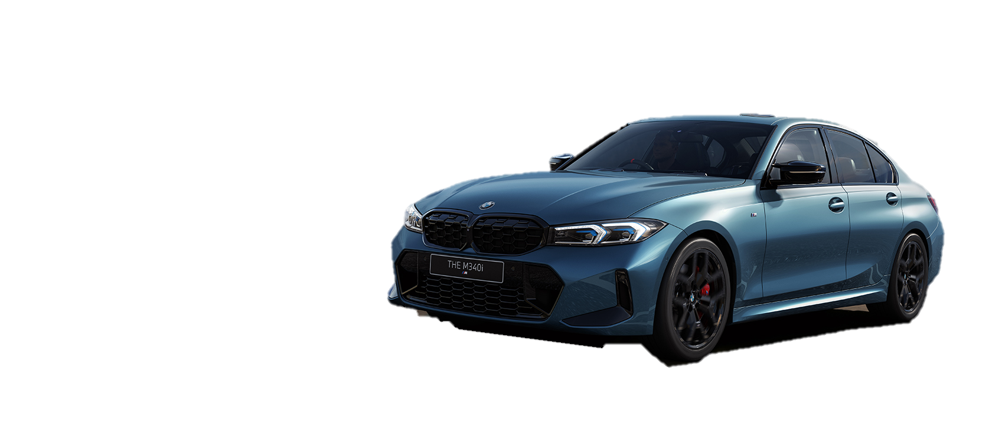
DESIGN DECISION
• Minimalist and professional color palette.
• Consistent typography across all pages.
• Responsive layout for multiple devices.
• Logical separation of web content and Excel data.

Slide 11
LIVE DEMO & GITHUB
• Live Website: https://drive.google.com/file/d/1qbTORb8tKAcDcQzytqaV3JHFEEUMa07Z/view?usp=sharing
• Source Code:
https://faran-sultan.github.io/DriveEase-CarRentalService/index.html

Slide 12

REFLECTION & NEXT STEPS
• Gained practical experience in web development and data integration.
• Learned to combine visual design with functional analysis.
• Future enhancements: online booking, database. integration, payment system.

Slide 13
THANK YOU

